Slide 1
Numerical
Methods
Twitter: @Owen134866
www.mathsfreeresourcelibrary.com

Slide 2



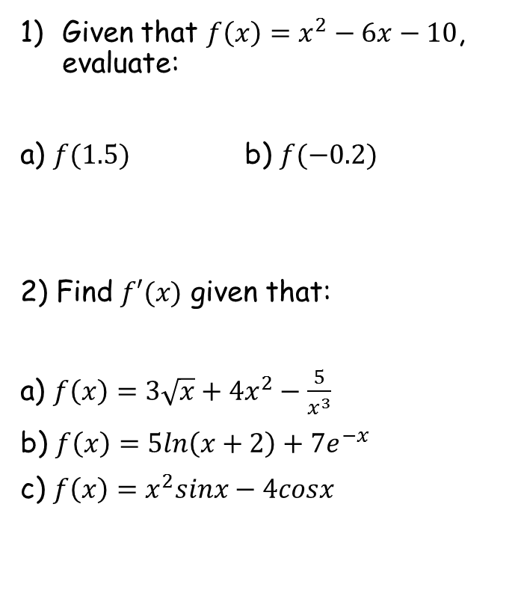






Prior Knowledge Check
Given that $f\left(x\right)=x^{2}−6x−10$, evaluate:
a) $f(1.5)$ b) $f(−0.2)$
2) Find $f′(x)$ given that:
a) $f\left(x\right)=3\sqrt{x}+{4x}^{2}−\frac{5}{x^{3}}$
b) $f\left(x\right)=5ln\left(x+2\right)+{7e}^{−x}$
c) $f\left(x\right)=x^{2}sinx−4cosx$
3) Given that $u_{n+1}=u_{n}+\frac{1}{u_{n}}$, and that $u_{0}=1$, find the values of $u_{1}$, $u_{2}$ and $u_{3}$.
$$u_{1}=2$$
$$u_{2}=2.5$$
$$u_{3}=2.9$$
$$3.25$$
$$11.24$$
$$f^{′}\left(x\right)=\frac{3}{2\sqrt{x}}+8x+\frac{15}{x^{4}}$$
$$f^{′}\left(x\right)=\frac{5}{x+2}−{7e}^{−x}$$
$$f^{′}\left(x\right)=x^{2}cosx+2xsinx+4sinx$$

Slide 3
Teachings for
Exercise 10A

Slide 4

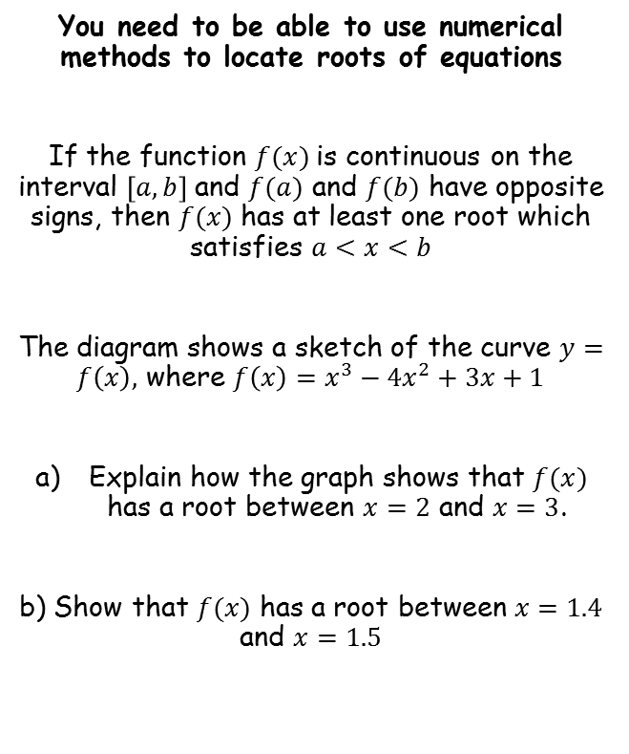
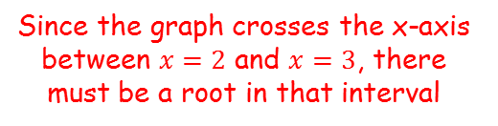


Numerical Methods
$$y$$
$$y=f(x)$$
You need to be able to use numerical methods to locate roots of equations
If the function $f(x)$is continuous on the interval $\left[a,b\right]$ and $f(a)$ and $f(b)$ have opposite signs, then $f(x)$ has at least one root which satisfies $a<x<b$
The diagram shows a sketch of the curve $y=f\left(x\right),$ where $f\left(x\right)=x^{3}−{4x}^{2}+3x+1$
Explain how the graph shows that $f(x)$ has a root between $x=2$ and $x=3$.
b) Show that $f(x)$ has a root between $x=1.4$ and $x=1.5$
1
$$x$$
-3
-2
-1
1
2
3
-1
Since the graph crosses the x-axis between $x=2$ and $x=3$, there must be a root in that interval
10A

Slide 5






Numerical Methods
$$y$$
$$y=f(x)$$
You need to be able to use numerical methods to locate roots of equations
If the function $f(x)$is continuous on the interval $\left[a,b\right]$ and $f(a)$ and $f(b)$ have opposite signs, then $f(x)$ has at least one root which satisfies $a<x<b$
The diagram shows a sketch of the curve $y=f\left(x\right),$ where $f\left(x\right)=x^{3}−{4x}^{2}+3x+1$
Explain how the graph shows that $f(x)$ has a root between $x=2$ and $x=3$.
b) Show that $f(x)$ has a root between $x=1.4$ and $x=1.5$
1
$$x$$
-3
-2
-1
1
2
3
-1
Sub in these two values and show that there is a change of sign…
$$f\left(x\right)=x^{3}−{4x}^{2}+3x+1$$
Sub in $x=1.4$
Sub in $x=1.5$
$$f\left(1.4\right)=0.104$$
$$f\left(1.5\right)=−0.125$$
Since there is a change of sign, there must be a root in the interval $\left[1.4,1.5\right]$
10A

Slide 6










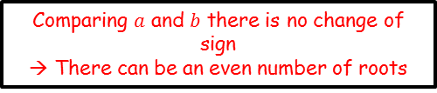



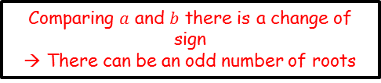
Numerical Methods
You need to be able to use numerical methods to locate roots of equations
It is important to consider the number of roots that are possible, and be careful of some special cases…
$$y$$
$$y$$
$$y$$
$$x$$
$$x$$
$$x$$
$$a$$
$$b$$
$$a$$
$$b$$
$$a$$
$$b$$
Comparing $a$ and $b$ there is a change of sign
→ There can be an odd number of roots
Comparing $a$ and $b$ there is no change of sign
→ There can be an even number of roots
Comparing $a$ and $b$ there is a change of sign
→ There could be no roots

Slide 7

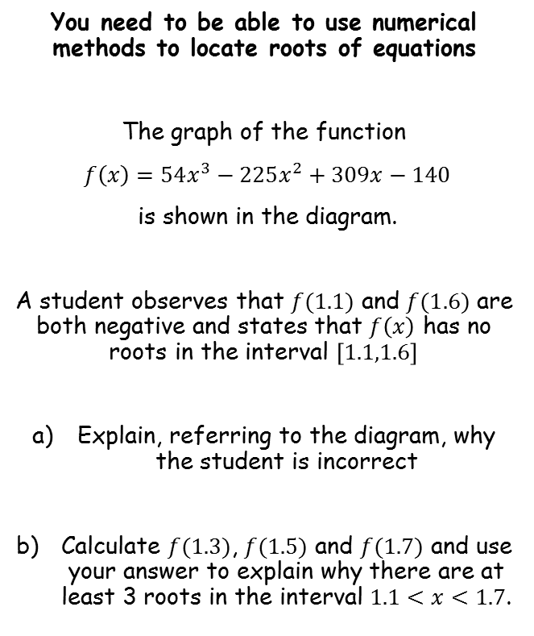

Numerical Methods
$$y$$
You need to be able to use numerical methods to locate roots of equations
The graph of the function
$f\left(x\right)=54x^{3}−225x^{2}+309x−140$
is shown in the diagram.
A student observes that $f(1.1)$ and $f(1.6)$ are both negative and states that $f\left(x\right)$ has no roots in the interval $\left[1.1,1.6\right]$
Explain, referring to the diagram, why the student is incorrect
Calculate $f(1.3)$, $f(1.5)$ and $f(1.7)$ and use your answer to explain why there are at least 3 roots in the interval $1.1<x<1.7$.
1
$$x$$
1
2
-1
If there is no sign change, although there could be no roots, it is also possible that there are 2, 4, 6, or any even number amount
→ From the diagram, since the curve crosses that axis 3 times, it is possible that there are actually 2 roots in the interval given
10A

Slide 8




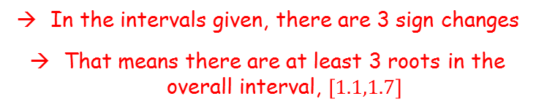
Numerical Methods
$$y$$
You need to be able to use numerical methods to locate roots of equations
The graph of the function
$f\left(x\right)=54x^{3}−225x^{2}+309x−140$
is shown in the diagram.
A student observes that $f(1.1)$ and $f(1.6)$ are both negative and states that $f\left(x\right)$ has no roots in the interval $\left[1.1,1.6\right]$
Explain, referring to the diagram, why the student is incorrect
Calculate $f(1.3)$, $f(1.5)$ and $f(1.7)$ and use your answer to explain why there are at least 3 roots in the interval $1.1<x<1.7$.
1
$$x$$
1
2
-1
$$f\left(1.1\right)=−0.476$$
Sign change
$$f\left(1.3\right)=0.088$$
Sign change
$$f\left(1.5\right)=−0.5$$
Sign change
$$f\left(1.7\right)=0.352$$
In the intervals given, there are 3 sign changes
That means there are at least 3 roots in the overall interval, $\left[1.1,1.7\right]$
10A

Slide 9



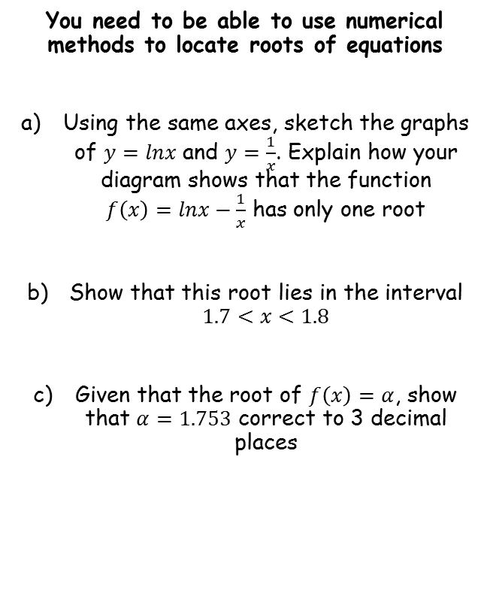




Numerical Methods
$$y=\frac{1}{x}$$
$$y$$
You need to be able to use numerical methods to locate roots of equations
Using the same axes, sketch the graphs of $y=lnx$ and $y=\frac{1}{x}$. Explain how your diagram shows that the function $f\left(x\right)=lnx−\frac{1}{x}$ has only one root
Show that this root lies in the interval $1.7<x<1.8$
Given that the root of $f\left(x\right)=α$, show that $α=1.753$ correct to 3 decimal places
$$y=lnx$$
$$x$$
-3
-2
-1
1
2
3
The roots of an equation are where it is equal to 0.
$$lnx−\frac{1}{x}=0$$
Add $\frac{1}{x}$
$$lnx=\frac{1}{x}$$
So the roots of the equation will be where the graphs cross, and we can see that they only cross in one place
10A

Slide 10


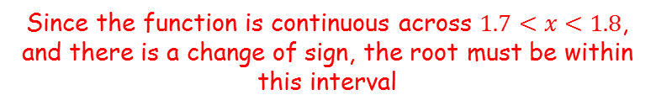



Numerical Methods
$$y=\frac{1}{x}$$
$$y$$
You need to be able to use numerical methods to locate roots of equations
Using the same axes, sketch the graphs of $y=lnx$ and $y=\frac{1}{x}$. Explain how your diagram shows that the function $f\left(x\right)=lnx−\frac{1}{x}$ has only one root
Show that this root lies in the interval $1.7<x<1.8$
Given that the root of $f\left(x\right)=α$, show that $α=1.753$ correct to 3 decimal places
$$y=lnx$$
$$x$$
-3
-2
-1
1
2
3
$$f\left(x\right)=lnx−\frac{1}{x}$$
Sub in $x=1.7$
Sub in $x=1.8$
$$f\left(1.7\right)=−0.0576$$
$$f\left(1.8\right)=0.0322$$
Since the function is continuous across $1.7<x<1.8$, and there is a change of sign, the root must be within this interval
10A

Slide 11



Numerical Methods
$$y=\frac{1}{x}$$
$$y$$
You need to be able to use numerical methods to locate roots of equations
Using the same axes, sketch the graphs of $y=lnx$ and $y=\frac{1}{x}$. Explain how your diagram shows that the function $f\left(x\right)=lnx−\frac{1}{x}$ has only one root
Show that this root lies in the interval $1.7<x<1.8$
Given that the root of $f\left(x\right)=α$, show that $α=1.753$ correct to 3 decimal places
$$y=lnx$$
$$x$$
-3
-2
-1
1
2
3
→ If the root rounds to 1.753 to 3dp, then it must be in the range 1.7525 to 1.7535
Root lies here
$$1.752$$
$$1.753$$
$$1.754$$
→ You need to sub in these limits and show that there is a change of sign between them…
10A

Slide 12

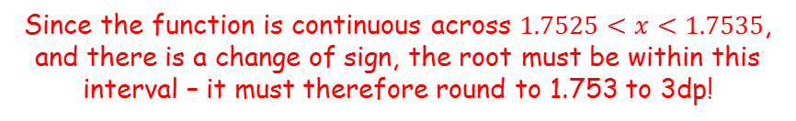



Numerical Methods
$$y=\frac{1}{x}$$
$$y$$
You need to be able to use numerical methods to locate roots of equations
Using the same axes, sketch the graphs of $y=lnx$ and $y=\frac{1}{x}$. Explain how your diagram shows that the function $f\left(x\right)=lnx−\frac{1}{x}$ has only one root
Show that this root lies in the interval $1.7<x<1.8$
Given that the root of $f\left(x\right)=α$, show that $α=1.753$ correct to 3 decimal places
$$y=lnx$$
$$x$$
-3
-2
-1
1
2
3
$$f\left(x\right)=lnx−\frac{1}{x}$$
Sub in $x=1.7525$
Sub in $x=1.7535$
$$=−0.00064$$
$$=0.00024$$
Since the function is continuous across $1.7525<x<1.7535$, and there is a change of sign, the root must be within this interval – it must therefore round to 1.753 to 3dp!
10A

Slide 13
Teachings for
Exercise 10B

Slide 14

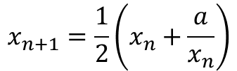
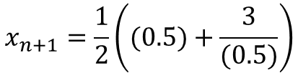
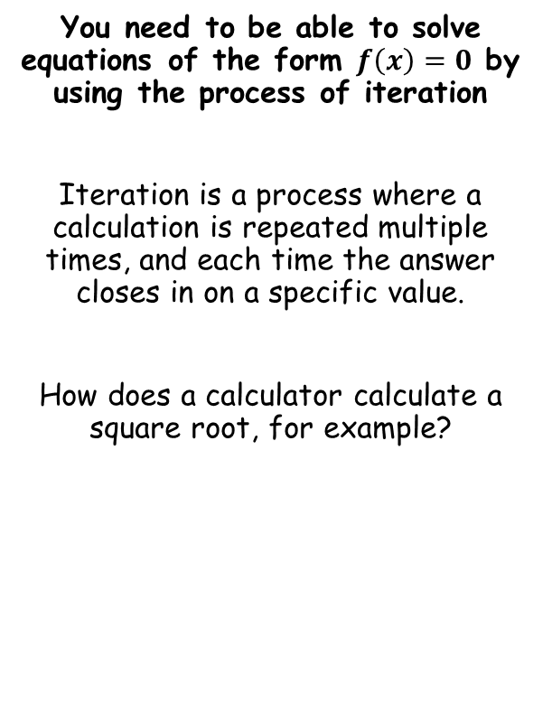
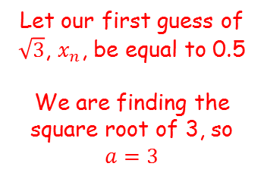


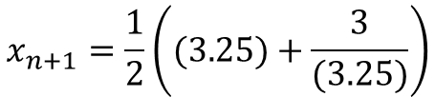
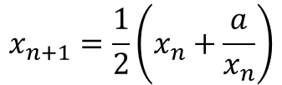
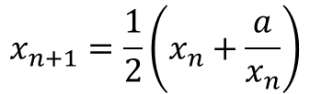
Numerical Methods
Let’s use this formula to calculate $\sqrt{3}$
You need to be able to solve equations of the form $f\left(x\right)=0$ by using the process of iteration
Iteration is a process where a calculation is repeated multiple times, and each time the answer closes in on a specific value.
How does a calculator calculate a square root, for example?
$$x_{n+1}=\frac{1}{2}\left(x_{n}+\frac{a}{x_{n}}\right)$$
Let our first guess of $\sqrt{3}$, $x_{n}$, be equal to 0.5
We are finding the square root of 3, so $a=3$
$$x_{n+1}=\frac{1}{2}\left((0.5)+\frac{3}{(0.5)}\right)$$
Calculate
$$x_{n+1}=3.25$$
$$x_{n+1}=\frac{1}{2}\left(x_{n}+\frac{a}{x_{n}}\right)$$
Perform the calculation again, but use the newly calculated value instead…
$$x_{n+1}=\frac{1}{2}\left(x_{n}+\frac{a}{x_{n}}\right)$$
$$x_{n+1}=\frac{1}{2}\left((3.25)+\frac{3}{(3.25)}\right)$$
The number we are rooting
Calculate
The ‘next’ number
The ‘current’ number
$$x_{n+1}=2.087$$
10B

Slide 15






Numerical Methods
Keep repeating these calculations, each time using the newly-calculated value…
You need to be able to solve equations of the form $f\left(x\right)=0$ by using the process of iteration
Iteration is a process where a calculation is repeated multiple times, and each time the answer closes in on a specific value.
How does a calculator calculate a square root, for example?
$$x_{0}=0.5$$
$$x_{1}=3.25$$
$$x_{2}=2.087…$$
$$x_{3}=1.7621…$$
$$x_{4}=1.7323…$$
$$x_{5}=1.7320…$$
$$x_{n+1}=\frac{1}{2}\left(x_{n}+\frac{a}{x_{n}}\right)$$
This process has given us the square root of 3 (and to improve the accuracy, you can just keep doing more iterations!)
A calculator can follow this process and do several iterations very quickly…
The number we are rooting
The ‘next’ number
The ‘current’ number
10B

Slide 16








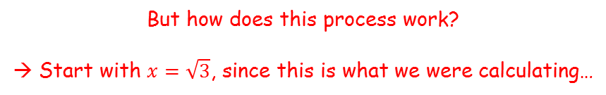

Numerical Methods
But how does this process work?
→ Start with $x=\sqrt{3}$, since this is what we were calculating…
You need to be able to solve equations of the form $f\left(x\right)=0$ by using the process of iteration
Iteration is a process where a calculation is repeated multiple times, and each time the answer closes in on a specific value.
How does a calculator calculate a square root, for example?
$$x=\sqrt{3}$$
Square both sides
$$x^{2}=3$$
Divide all by 2
$$\frac{1}{2}x^{2}=\frac{3}{2}$$
Add $\frac{1}{2}x^{2}$ to both sides
$$x^{2}=\frac{1}{2}x^{2}+\frac{3}{2}$$
Divide all by $x$
$$x=\frac{1}{2}x+\frac{3}{2x}$$
Factorise $\frac{1}{2}$ out of the right side
$$x_{n+1}=\frac{1}{2}\left(x_{n}+\frac{a}{x_{n}}\right)$$
$$x=\frac{1}{2}\left(x+\frac{3}{x}\right)$$
The solution to this equation will be the same as the solution to the original one
These can be found by drawing graphs of each one and finding where they cross…
10B

Slide 17
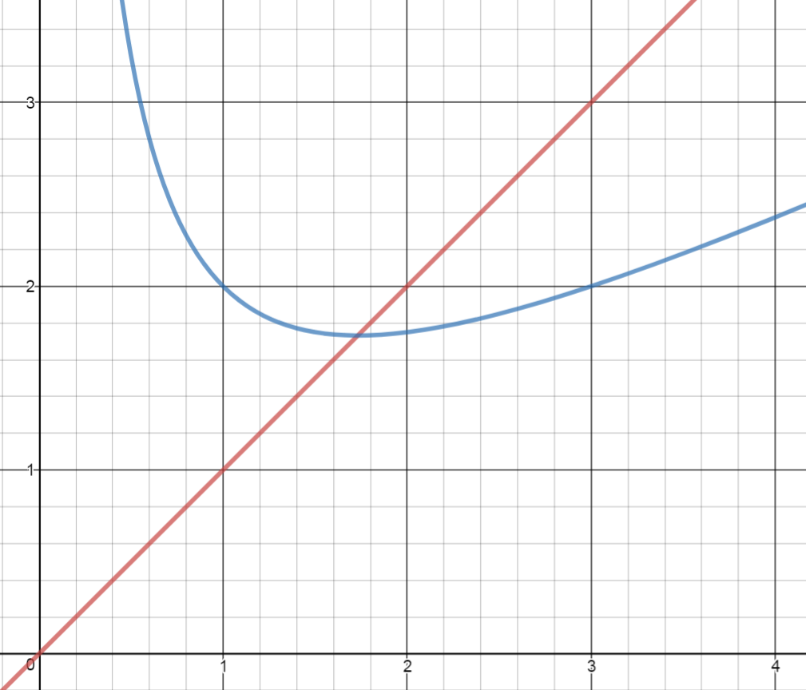









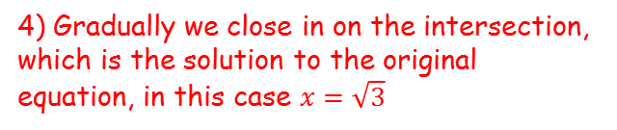











Numerical Methods
$$x_{0}=0.5$$
$$x_{1}=3.25$$
$$x_{2}=2.087…$$
$$x_{3}=1.7621…$$
$$x_{4}=1.7323…$$
$$y=x$$
$$x_{5}=1.7320…$$
$$y=\frac{1}{2}\left(x+\frac{3}{x}\right)$$
You need to be able to solve equations of the form $f\left(x\right)=0$ by using the process of iteration
$$x=3.25$$
$$x=\frac{1}{2}\left(x+\frac{3}{x}\right)$$
$$x=2.087$$
$$x=1.7621$$
$$y=\frac{1}{2}\left(x+\frac{3}{x}\right)$$
$$y=x$$
We choose a value for $x$ (in this case we chose 0.5), and sub it into the equation on the right side (the blue line)
The answer ($y$) is the next value ($x$) we substitute in. Since the red line is $y=x$, we can show this on the diagram
We then substitute this into the equation on the right side again (the blue line)
$$x=0.5$$
$$x=3.25$$
$$x=2.087$$
$$x=1.7621$$
4) Gradually we close in on the intersection, which is the solution to the original equation, in this case $x=\sqrt{3}$
10B

Slide 18
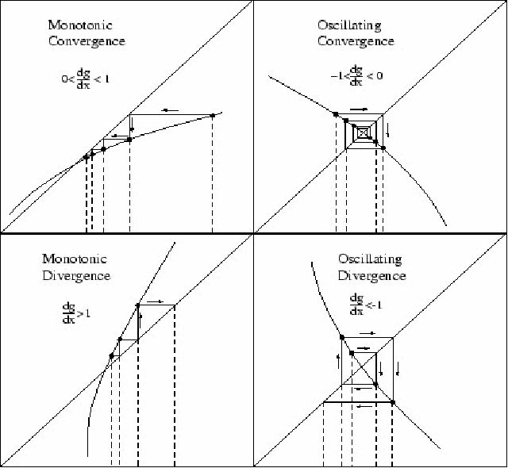
Numerical Methods
The diagram you just saw is sometimes called a convergence cobweb, and can appear in different types…
It is important to note that sometimes this technique causes an answer to diverge away from the solution instead of towards it
→ In that case, the ‘fix’ is usually to choose a different starting value…
10B

Slide 19



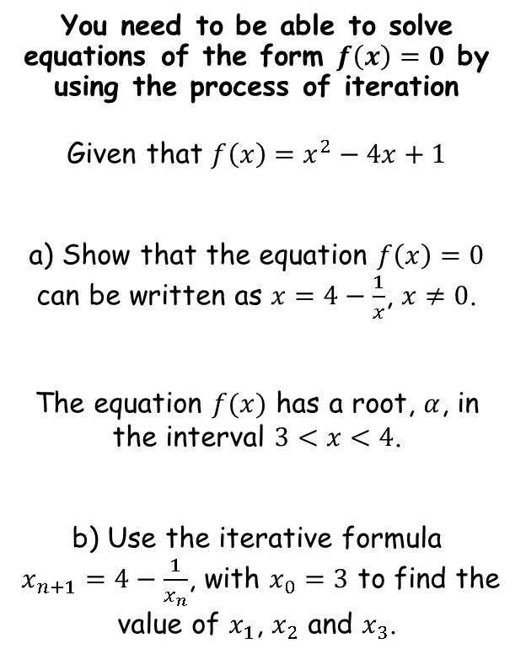




Numerical Methods
You need to be able to solve equations of the form $f\left(x\right)=0$ by using the process of iteration
Given that $f\left(x\right)=x^{2}−4x+1$
a) Show that the equation $f\left(x\right)=0$ can be written as $x=4−\frac{1}{x}$, $x≠0$.
The equation $f(x)$ has a root, $α$, in the interval $3<x<4$.
b) Use the iterative formula
$x_{n+1}=4−\frac{1}{x_{n}}$, with $x_{0}=3$ to find the value of $x_{1}$, $x_{2}$ and $x_{3}$.
$$f\left(x\right)=x^{2}−4x+1$$
Set $f(x)=0$
$$0=x^{2}−4x+1$$
Add $4x$ and subtract 1
$$4x−1=x^{2}$$
$$4−\frac{1}{x}=x$$
Divide all by $x$
When rearranging, you should look at the formula you are aiming for first…
This can give you an idea as to how to do the rearrangement
10B

Slide 20












Numerical Methods
$$x_{n+1}=4−\frac{1}{x_{n}}$$
$$x_{n+1}=4−\frac{1}{x_{n}}$$
You need to be able to solve equations of the form $f\left(x\right)=0$ by using the process of iteration
Given that $f\left(x\right)=x^{2}−4x+1$
a) Show that the equation $f\left(x\right)=0$ can be written as $x=4−\frac{1}{x}$, $x≠0$.
The equation $f(x)$ has a root, $α$, in the interval $3<x<4$.
b) Use the iterative formula
$x_{n+1}=4−\frac{1}{x_{n}}$, with $x_{0}=3$ to find the value of $x_{1}$, $x_{2}$ and $x_{3}$.
Write using the specific terms
Write using the specific terms
$$x_{1}=4−\frac{1}{x_{0}}$$
$$x_{2}=4−\frac{1}{x_{1}}$$
Sub values in
Sub values in
$$x_{1}=4−\frac{1}{3}$$
$$x_{2}=4−\frac{1}{3.66…}$$
Calculate
Calculate
$$x_{1}=3.66…$$
$$x_{2}=3.727…$$
$$x_{n+1}=4−\frac{1}{x_{n}}$$
Write using the specific terms
$$x_{3}=4−\frac{1}{x_{2}}$$
Sub values in
$$x_{3}=4−\frac{1}{3.727…}$$
Calculate
$$x_{3}=3.731…$$
10B

Slide 21



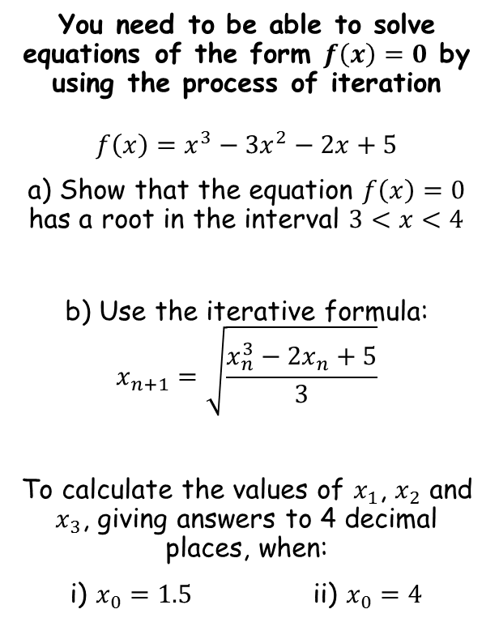



Numerical Methods
$$f\left(x\right)=x^{3}−{3x}^{2}−2x+5$$
You need to be able to solve equations of the form $f\left(x\right)=0$ by using the process of iteration
$$f\left(x\right)=x^{3}−{3x}^{2}−2x+5$$
a) Show that the equation $f\left(x\right)=0$ has a root in the interval $3<x<4$
b) Use the iterative formula:
$$x_{n+1}=\sqrt{\frac{x_{n}^{3}−{2x}_{n}+5}{3}}$$
To calculate the values of $x_{1}$, $x_{2}$ and $x_{3}$, giving answers to 4 decimal places, when:
i) $x_{0}=1.5$ ii) $x_{0}=4$
Sub in $x=4$
Sub in $x=3$
$$f\left(3\right)=−1$$
$$f\left(4\right)=13$$
Since the function is continuous, and there is a change of sign, there must be a root in the interval $3<x<4$
10B

Slide 22


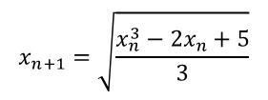
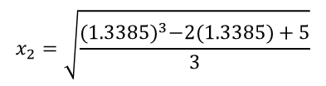

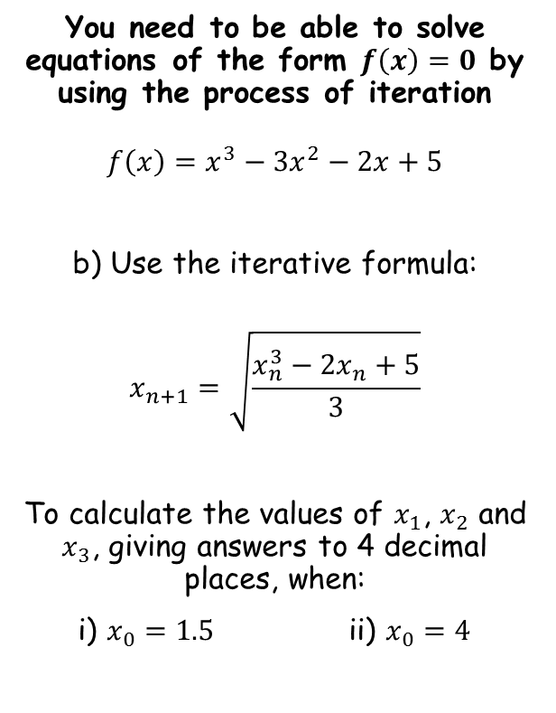
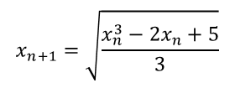


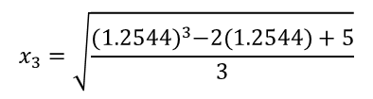
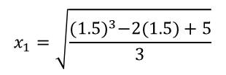
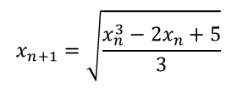

Numerical Methods
$$x_{n+1}=\sqrt{\frac{x_{n}^{3}−{2x}_{n}+5}{3}}$$
$$x_{n+1}=\sqrt{\frac{x_{n}^{3}−{2x}_{n}+5}{3}}$$
You need to be able to solve equations of the form $f\left(x\right)=0$ by using the process of iteration
$$f\left(x\right)=x^{3}−{3x}^{2}−2x+5$$
b) Use the iterative formula:
$$x_{n+1}=\sqrt{\frac{x_{n}^{3}−{2x}_{n}+5}{3}}$$
To calculate the values of $x_{1}$, $x_{2}$ and $x_{3}$, giving answers to 4 decimal places, when:
i) $x_{0}=1.5$ ii) $x_{0}=4$
Sub in $x_{0}$
Sub in $x_{1}$
$$x_{1}=\sqrt{\frac{{(1.5)}^{3}−2(1.5)+5}{3}}$$
$$x_{2}=\sqrt{\frac{{(1.3385)}^{3}−2(1.3385)+5}{3}}$$
Work out
Work out
$$x_{1}=1.3385$$
$$x_{2}=1.2544$$
$$x_{n+1}=\sqrt{\frac{x_{n}^{3}−{2x}_{n}+5}{3}}$$
Sub in $x_{2}$
$$x_{3}=\sqrt{\frac{{(1.2544)}^{3}−2(1.2544)+5}{3}}$$
Work out
$$x_{3}=1.2200$$
In this case, the solutions are getting closer to a root. This sequence is therefore convergent.
10B

Slide 23

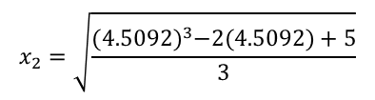


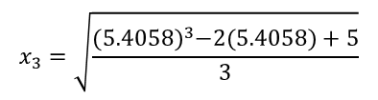
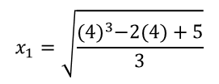
Numerical Methods
$$x_{n+1}=\sqrt{\frac{x_{n}^{3}−{2x}_{n}+5}{3}}$$
$$x_{n+1}=\sqrt{\frac{x_{n}^{3}−{2x}_{n}+5}{3}}$$
You need to be able to solve equations of the form $f\left(x\right)=0$ by using the process of iteration
$$f\left(x\right)=x^{3}−{3x}^{2}−2x+5$$
b) Use the iterative formula:
$$x_{n+1}=\sqrt{\frac{x_{n}^{3}−{2x}_{n}+5}{3}}$$
To calculate the values of $x_{1}$, $x_{2}$ and $x_{3}$, giving answers to 4 decimal places, when:
i) $x_{0}=1.5$ ii) $x_{0}=4$
Sub in $x_{0}$
Sub in $x_{1}$
$$x_{1}=\sqrt{\frac{{(4)}^{3}−2(4)+5}{3}}$$
$$x_{2}=\sqrt{\frac{{(4.5092)}^{3}−2(4.5092)+5}{3}}$$
Work out
Work out
$$x_{1}=4.5092$$
$$x_{2}=5.4058$$
$$x_{n+1}=\sqrt{\frac{x_{n}^{3}−{2x}_{n}+5}{3}}$$
Sub in $x_{2}$
$$x_{3}=\sqrt{\frac{{(5.4058)}^{3}−2(5.4058)+5}{3}}$$
Work out
$$x_{3}=7.1219$$
In this case, the solutions are getting further to a root. This sequence is therefore divergent.
10B

Slide 24
Teachings for
Exercise 10C

Slide 25







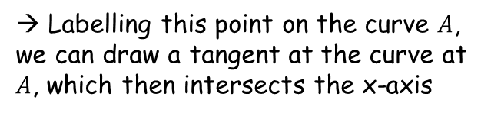




Numerical Methods
$$f(x)$$
$$f(x)$$
$$A$$
The Newton-Raphson method is another technique you can use to find roots of equations of the form $f\left(x\right)=0$
Start with a curve $f(x)$, with a root as shown
→ Choosing a ‘first guess’ of the value of the root, $x_{1}$, we can then label some more information…
→ The vertical distance from the x-axis to the curve for our chosen value, $x_{1}$, is $f(x_{1})$
(by subbing the value into the equation of the line)
$$Tangent at A$$
$$f(x_{1})$$
$$x$$
$$root$$
$$x_{4}$$
$$x_{3}$$
$$x_{2}$$
$$x_{1}$$
→ Labelling this point on the curve $A$, we can draw a tangent at the curve at $A$, which then intersects the x-axis
→ Notice that the new intersection is closer to the root than our first guess
Look what happens if we follow this process repeatedly…
We get closer to the actual root!
10C

Slide 26


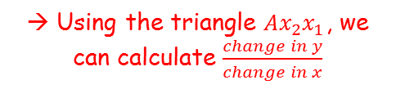



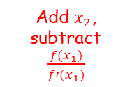

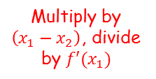
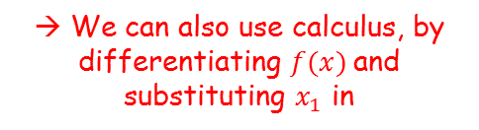
Numerical Methods
$$f(x)$$
$$f(x)$$
$$A$$
The Newton-Raphson method is another technique you can use to find roots of equations of the form $f\left(x\right)=0$
However, we need to create an algebraic method for this (it will naturally be iterative since, as you just saw, it is a repeating process)
$$Tangent at A$$
$$f(x_{1})$$
$$x$$
$$root$$
$$x_{2}$$
$$x_{1}$$
Gradient of the tangent (1)
Gradient of the tangent (2)
$$\frac{f(x_{1})}{x_{1}−x_{2}}=f′(x_{1})$$
Multiply by $\left(x_{1}−x_{2}\right)$, divide by $f′(x_{1})$
→ Using the triangle $Ax_{2}x_{1}$, we can calculate $\frac{change in y}{change in x}$
→ We can also use calculus, by differentiating $f(x)$and substituting $x_{1}$ in
$$\frac{f(x_{1})}{f′(x_{1}) }=x_{1}−x_{2}$$
$$=\frac{f(x_{1})}{x_{1}−x_{2}}$$
Add $x_{2}$, subtract $\frac{f(x_{1})}{f′(x_{1})}$
$$=f′(x_{1})$$
$$x_{2}=x_{1}−\frac{f(x_{1})}{f′(x_{1}) }$$
These expressions must be equal, since they both represent the same gradient…
10C

Slide 27

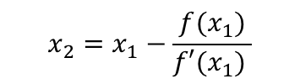


Numerical Methods
$$x_{n+1}=x_{n}−\frac{f(x_{n})}{f′(x_{n}) }$$
$$f(x)$$
$$f(x)$$
$$A$$
The Newton-Raphson method is another technique you can use to find roots of equations of the form $f\left(x\right)=0$
This is the Newton-Raphson formula:
For iteration, it is written as follows…
$$Tangent at A$$
$$f(x_{1})$$
$$x$$
$$root$$
$$x_{2}$$
$$x_{1}$$
$$x_{2}=x_{1}−\frac{f(x_{1})}{f′(x_{1}) }$$
$$x_{n+1}=x_{n}−\frac{f(x_{n})}{f′(x_{n}) }$$
10C

Slide 28







Numerical Methods
$$x_{n+1}=x_{n}−\frac{f(x_{n})}{f′(x_{n}) }$$
$$f(x)$$
$$f(x)$$
The Newton-Raphson method is another technique you can use to find roots of equations of the form $f\left(x\right)=0$
There are some cases where the Newton-Raphson method may be less effective, or fail completely
Suppose we chose a ‘first guess’ $x_{1}$, which corresponds to a value on the curve close to a turning point…
In this case, the tangent drawn would lead to a point much further from the actual roots
The method can still work, but it could take many iterations to be effective
$$x_{1}$$
$$x$$
$$Tangent at A$$
$$A$$
10C

Slide 29




Numerical Methods
$$x_{n+1}=x_{n}−\frac{f(x_{n})}{f′(x_{n}) }$$
$$f(x)$$
$$f(x)$$
The Newton-Raphson method is another technique you can use to find roots of equations of the form $f\left(x\right)=0$
There are some cases where the Newton-Raphson method may be less effective, or fail completely
Suppose we chose a ‘first guess’ $x_{1}$, which corresponds to a value which is at a turning point
In this case, the tangent drawn will never intersect the x-axis, so the method fails
If $x_{1}$ leads to a turning point, then $f′(x_{1})=0$, and we cannot divide by 0 (check the formula above)
$$x_{1}$$
$$x$$
$$Tangent at A$$
$$A$$
10C

Slide 30


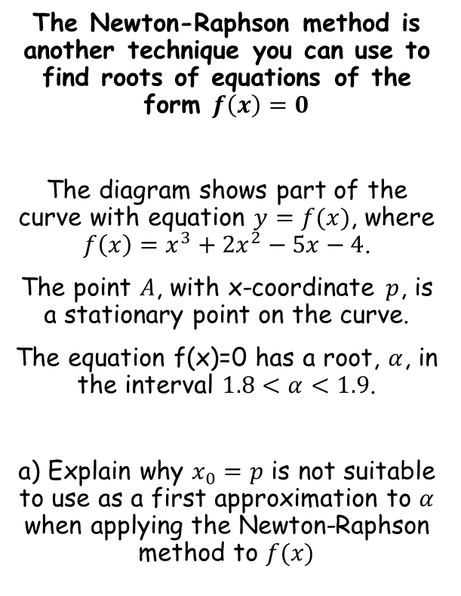
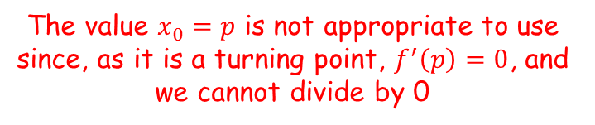
Numerical Methods
$$x_{n+1}=x_{n}−\frac{f(x_{n})}{f′(x_{n}) }$$
$$y=f(x)$$
$$y$$
The Newton-Raphson method is another technique you can use to find roots of equations of the form $f\left(x\right)=0$
The diagram shows part of the curve with equation $y=f(x)$, where $f\left(x\right)=x^{3}+2x^{2}−5x−4$.
The point $A$, with x-coordinate $p$, is a stationary point on the curve.
The equation f(x)=0 has a root, $α$, in the interval $1.8<α<1.9$.
a) Explain why $x_{0}=p$ is not suitable to use as a first approximation to $α$ when applying the Newton-Raphson method to $f(x)$
$$p$$
$$x$$
$$A$$
The value $x_{0}=p$ is not appropriate to use since, as it is a turning point, $f^{′}\left(p\right)=0$, and we cannot divide by 0
10C

Slide 31





Numerical Methods
$$x_{n+1}=x_{n}−\frac{f(x_{n})}{f′(x_{n}) }$$
$$y=f(x)$$
$$y$$
The Newton-Raphson method is another technique you can use to find roots of equations of the form $f\left(x\right)=0$
The diagram shows part of the curve with equation $y=f(x)$, where $f\left(x\right)=x^{3}+2x^{2}−5x−4$.
The point $A$, with x-coordinate $p$, is a stationary point on the curve.
The equation f(x)=0 has a root, $α$, in the interval $1.8<α<1.9$.
b) Using $x_{0}=2$ as a first approximation to $α$, apply the Newton-Raphson method procedure twice to find a new approximation for $α$, to 3dp.
$$p$$
$$x$$
$$A$$
To apply the Newton-Raphson procedure, we first need to find $f′(x)$
$$f\left(x\right)=x^{3}+2x^{2}−5x−4$$
Differentiate with respect to $x$
$$f′\left(x\right)={3x}^{2}+4x−5$$
10C

Slide 32








Numerical Methods
$$x_{n+1}=x_{n}−\frac{f(x_{n})}{f′(x_{n}) }$$
The Newton-Raphson method is another technique you can use to find roots of equations of the form $f\left(x\right)=0$
The diagram shows part of the curve with equation $y=f(x)$, where $f\left(x\right)=x^{3}+2x^{2}−5x−4$.
The point $A$, with x-coordinate $p$, is a stationary point on the curve.
The equation f(x)=0 has a root, $α$, in the interval $1.8<α<1.9$.
b) Using $x_{0}=2$ as a first approximation to $α$, apply the Newton-Raphson method procedure twice to find a new approximation for $α$, to 3dp.
$$f\left(x\right)=x^{3}+2x^{2}−5x−4$$
$$f′\left(x\right)={3x}^{2}+4x−5$$
$x_{0}=2$
$$x_{n+1}=x_{n}−\frac{f(x_{n})}{f′(x_{n}) }$$
Write using the appropriate numbers (if needed)
$$x_{1}=x_{0}−\frac{f(x_{0})}{f′(x_{0}) }$$
Sub $x_{0}=2$ into both $f(x)$, on the numerator, and $f′(x)$, on the denominator
$$x_{1}=2−\frac{{(2)}^{3}+2{(2)}^{2}−5(2)−4 }{{3(2)}^{2}+4(2)−5 }$$
$$x_{1}=1.8666…$$
10C

Slide 33





Numerical Methods
$$x_{n+1}=x_{n}−\frac{f(x_{n})}{f′(x_{n}) }$$
The Newton-Raphson method is another technique you can use to find roots of equations of the form $f\left(x\right)=0$
The diagram shows part of the curve with equation $y=f(x)$, where $f\left(x\right)=x^{3}+2x^{2}−5x−4$.
The point $A$, with x-coordinate $p$, is a stationary point on the curve.
The equation f(x)=0 has a root, $α$, in the interval $1.8<α<1.9$.
b) Using $x_{0}=2$ as a first approximation to $α$, apply the Newton-Raphson method procedure twice to find a new approximation for $α$, to 3dp.
$$f\left(x\right)=x^{3}+2x^{2}−5x−4$$
$$f′\left(x\right)={3x}^{2}+4x−5$$
$x_{0}=2$
$$x_{1}=1.8666…$$
$$x_{n+1}=x_{n}−\frac{f(x_{n})}{f′(x_{n}) }$$
Write using the appropriate numbers (if needed)
$$x_{2}=x_{1}−\frac{f(x_{1})}{f′(x_{1}) }$$
$$x_{2}=1.8666−\frac{{(1.8666)}^{3}+2{(1.8666)}^{2}−5(1.8666)−4 }{{3(1.8666)}^{2}+4(1.8666)−5 }$$
$x_{2}=1.856$ (3dp)
Sub $x_{1}=1.8666$ into both $f(x)$, on the numerator, and $f′(x)$, on the denominator
10C

Slide 34











Numerical Methods
$$x_{n+1}=x_{n}−\frac{f(x_{n})}{f′(x_{n}) }$$
The Newton-Raphson method is another technique you can use to find roots of equations of the form $f\left(x\right)=0$
The diagram shows part of the curve with equation $y=f(x)$, where $f\left(x\right)=x^{3}+2x^{2}−5x−4$.
The point $A$, with x-coordinate $p$, is a stationary point on the curve.
The equation f(x)=0 has a root, $α$, in the interval $1.8<α<1.9$.
c) By considering the change of sign in $f(x)$ over an appropriate interval, show that your answer to part b is accurate to 3 decimal places
→ If the root rounds to 1.856 to 3dp, then it must be in the range 1.8555 to 1.8565
Root lies here
$$1.855$$
$$1.856$$
$$1.857$$
→ You need to sub in these limits and show that there is a change of sign between them…
$$f\left(x\right)=x^{3}+2x^{2}−5x−4$$
Sub in $x=1.8555$
Sub in $x=1.8565$
$$x_{2}=1.856$$
$$=−0.00348$$
$$=0.00928$$
Since the function is continuous across $1.8555<x<1.8565$, and there is a change of sign, the root must be within this interval – it must therefore round to 1.856 to 3dp!
10C

Slide 35
Teachings for
Exercise 10D

Slide 36





Numerical Methods
You need to be able to use the techniques you have learned in this chapter to model more practical situations
The price of a car in £s, x years after purchase, is modelled by the function:
$f\left(x\right)=15000{\left(0.85\right)}^{x}−1000sinx$, $x>0$
a) Use the model to find the value of the car 10 years after purchase
$$f\left(x\right)=15000{\left(0.85\right)}^{x}−1000sinx$$
Sub in $x=10$ (calculator needs to be in radians)
$$f\left(10\right)=15000{\left(0.85\right)}^{(10)}−1000sin⁡(10)$$
Calculate
$$f\left(10\right)=3497.13$$
So the value of the car will be £3497.13 (remember to round appropriately for pounds)
10D

Slide 37







Numerical Methods
You need to be able to use the techniques you have learned in this chapter to model more practical situations
The price of a car in £s, x years after purchase, is modelled by the function:
$f\left(x\right)=15000{\left(0.85\right)}^{x}−1000sinx$, $x>0$
b) Show that $f(x)$ has a root between 19 and 20
$$f\left(x\right)=15000{\left(0.85\right)}^{x}−1000sinx$$
Sub in $x=19$
Sub in $x=20$
$$=534.11$$
$$=−331.55$$
Since the function changes sign across $19<x<20$, and there is a change of sign, there must be at least one root in the interval 19-20.
10D

Slide 38






Numerical Methods
You need to be able to use the techniques you have learned in this chapter to model more practical situations
The price of a car in £s, x years after purchase, is modelled by the function:
$f\left(x\right)=15000{\left(0.85\right)}^{x}−1000sinx$, $x>0$
c) Find $f′(x)$
$$f\left(x\right)=15000{\left(0.85\right)}^{x}−1000sinx$$
Differentiate with respect to $x$, using techniques you have learnt previously
$$f′\left(x\right)=$$
$$15000{\left(0.85\right)}^{x}(ln0.85)$$
$$− 1000cosx$$
10D

Slide 39






Numerical Methods
$$x_{n+1}=x_{n}−\frac{f(x_{n})}{f′(x_{n}) }$$
Sub $x_{0}=19.5$ into both $f(x)$, on the numerator, and $f′(x)$, on the denominator
You need to be able to use the techniques you have learned in this chapter to model more practical situations
The price of a car in £s, x years after purchase, is modelled by the function:
$f\left(x\right)=15000{\left(0.85\right)}^{x}−1000sinx$, $x>0$
d) Taking 19.5 as a first approximation, apply the Newton-Raphson method once to find a second approximation for the time when the value of the car is zero. Give your answer to 3dp
$$x_{n+1}=x_{n}−\frac{f(x_{n})}{f′(x_{n}) }$$
Write using the appropriate numbers (if needed)
$$x_{1}=x_{0}−\frac{f(x_{0})}{f′(x_{0}) }$$
$$x_{1}=(19.5)−\frac{15000{\left(0.85\right)}^{(19.5)}−1000sin⁡(19.5)}{15000{\left(0.85\right)}^{(19.5)}\left(ln0.85\right)−1000cos⁡(19.5)}$$
$$f^{′}(x)=15000{\left(0.85\right)}^{x}\left(ln0.85\right)−1000cosx$$
$$x_{1}=19.528$$
Calculate
10D

Slide 40

Numerical Methods
$$x_{n+1}=x_{n}−\frac{f(x_{n})}{f′(x_{n}) }$$
You need to be able to use the techniques you have learned in this chapter to model more practical situations
The price of a car in £s, x years after purchase, is modelled by the function:
$f\left(x\right)=15000{\left(0.85\right)}^{x}−1000sinx$, $x>0$
e) Criticise this model with respect to the value of the car as it gets older
$$f^{′}(x)=15000{\left(0.85\right)}^{x}\left(ln0.85\right)−1000cosx$$
Beyond the value calculated in part d) (19.528), the car will take a negative value.
However, this is unrealistic, so the model seems unreasonable for cars that are around 20 years old.
10D

